Slide 1
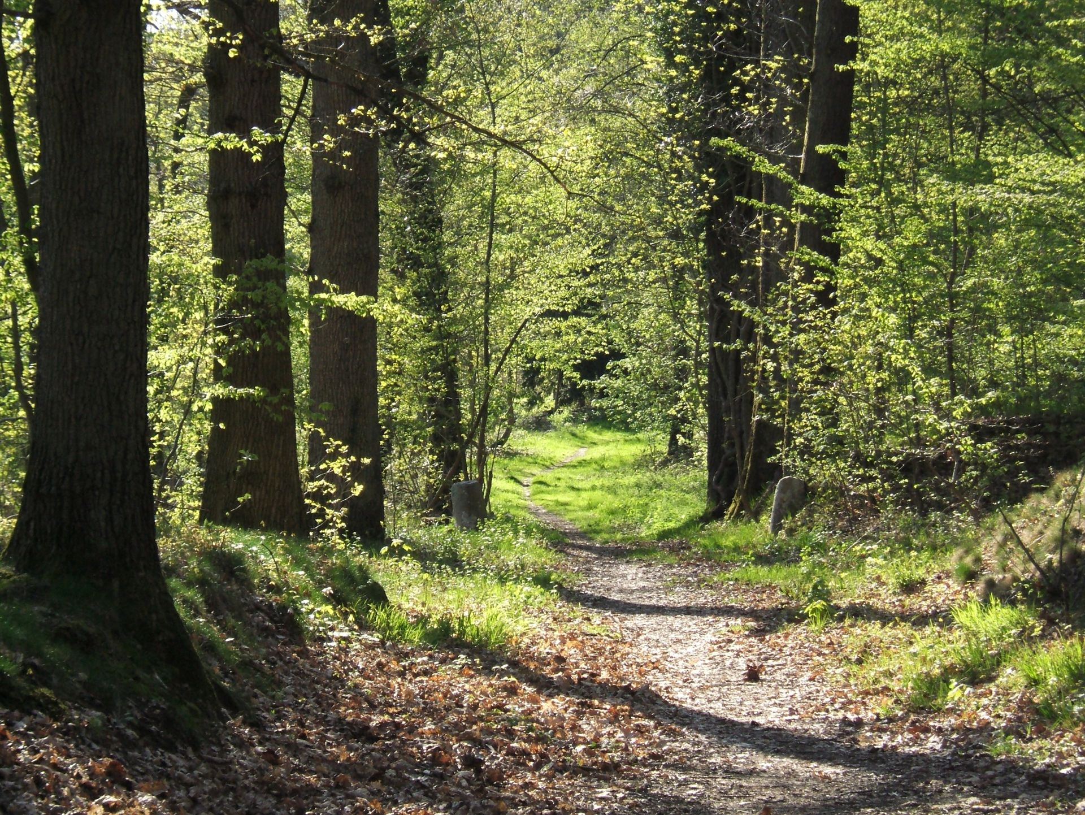
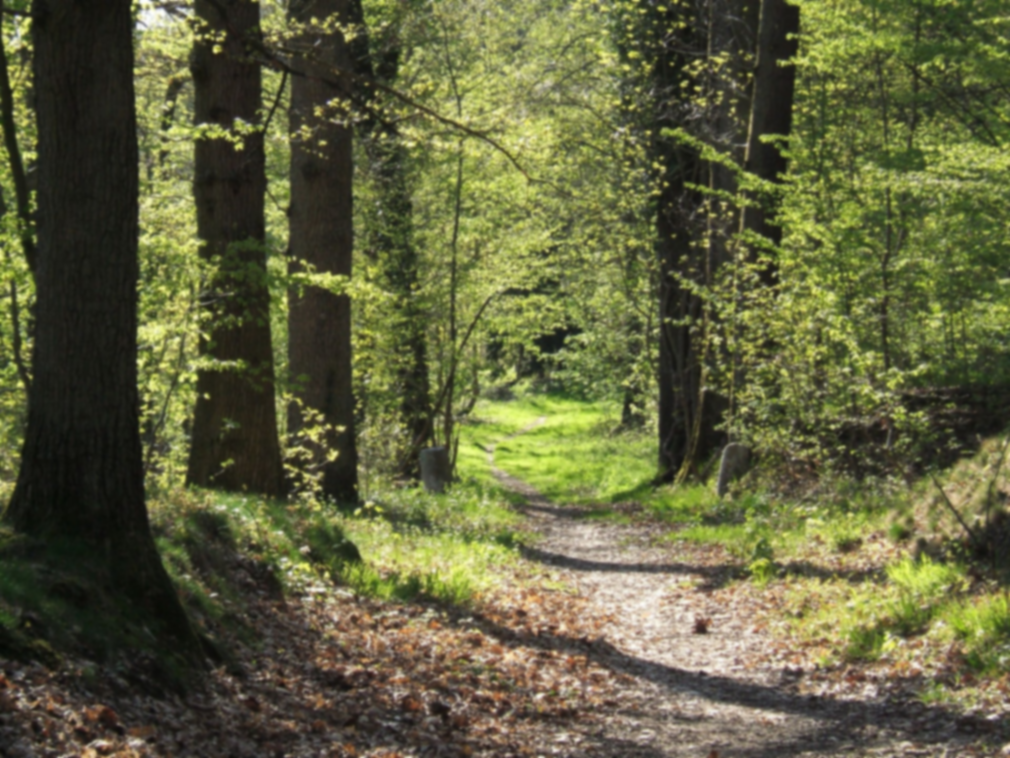


Laboratoire d’ingénierie pour les systems complexes
Forest scale planning
For multifunctionality
Clémentine de Montgolfier
Jean-Denis Mathias (LISC), Jean-Baptiste Pichancourt (LISC), Marion Jourdan (SILVA)
Par Esteban47map — Travail personnel, CC BY-SA 4.0, https://commons.wikimedia.org/w/index.php?curid=72045657

Slide 2
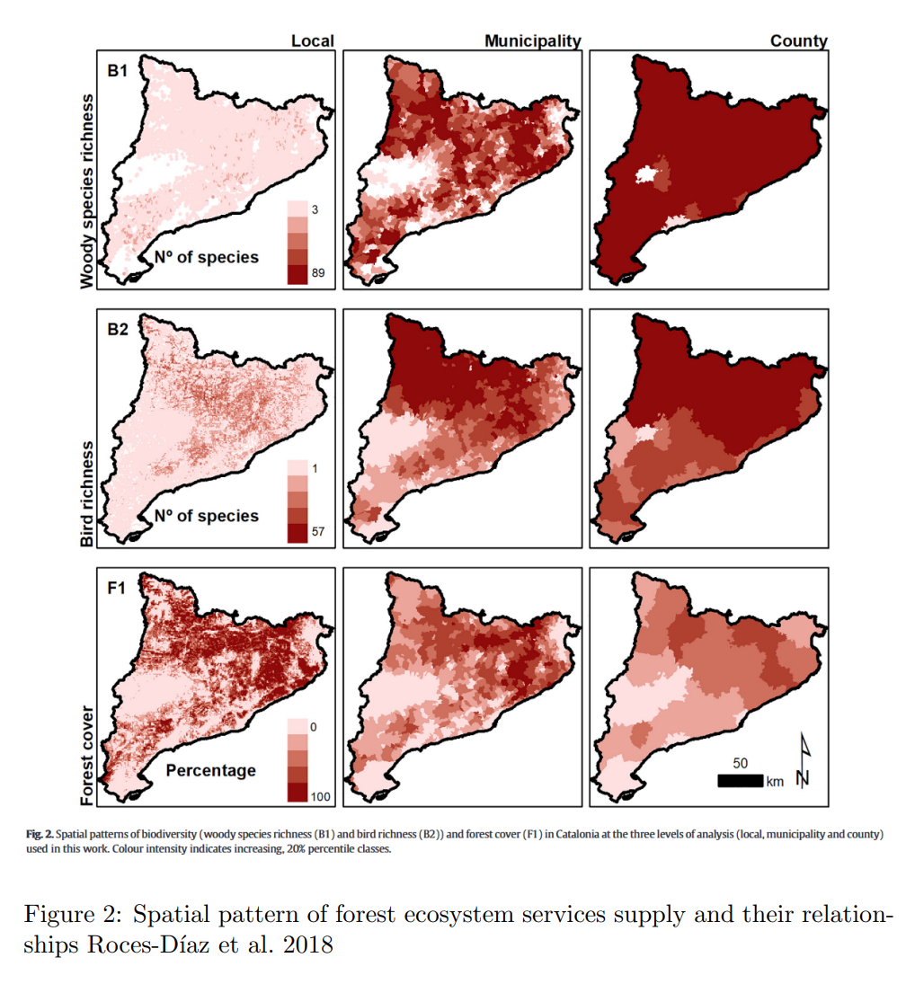
Importance of scale in forest ecology

Slide 3
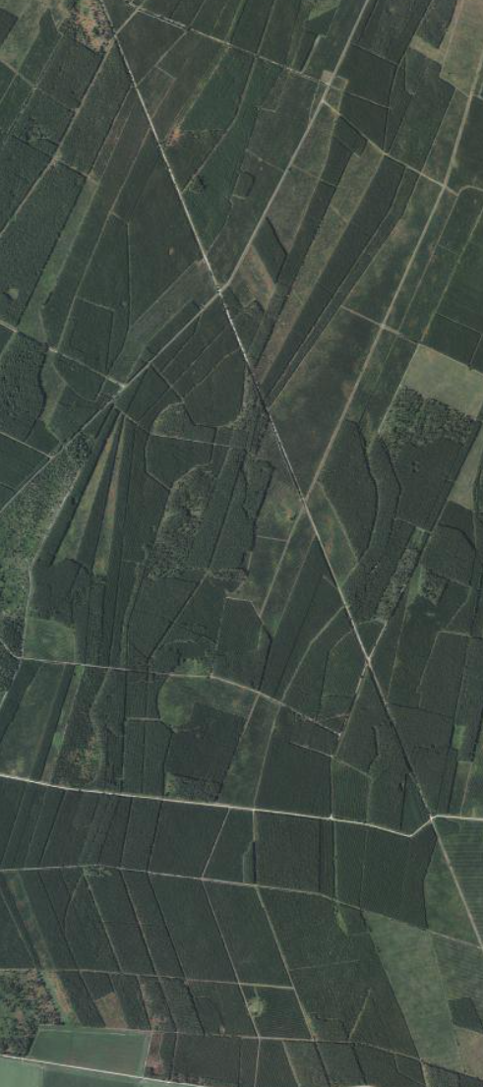
Forest planning scale
Current Planning Issues
Stand-level decisions dominate
Highly fragmented ownership and planning
Lack of coordinated management
But Ecosystem Processes Operate at Larger Scales
Windthrow vulnerability
Pest outbreaks and wildfire spread
Seed dispersal dynamics
Habitat connectivity and biodiversity conservation

Slide 4
Forest planning scale
Current Planning Issues
Stand-level decisions dominate
Highly fragmented ownership and planning
Lack of coordinated management
But Ecosystem Processes Operate at Larger Scales
Windthrow vulnerability
Pest outbreaks and wildfire spread
Seed dispersal dynamics
Habitat connectivity and biodiversity conservation
=> Need for a multi-scale decision system to take into account both local and global constraints

Slide 5
